Slide 1

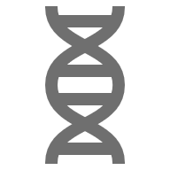
Maximum Subarray and Variants - Biotech
Presented by:
Connor Jordan
Lane Goss
Patrick Galloway
CSC 2400 – Design of Algorithms

Slide 2
Maximum Subarray Problem
The Problem:
Given a long sequence of numerical values, we need to find the contiguous region with the greatest total strength or intensity.
Why we study it:
It appears in many real scientific and engineering problems that involve analyzing signals.
Our Core Search Questions Going In:
Which of the three algorithms handles the maximum subarray problem most efficiently?
Are there cases where a theoretically slower algorithm performs better on certain inputs?

Slide 3

Relation To Biotechnology
Biological data often form as numerical sequences
Examples:
  Changes in Gene Expression Over Time
  Protein activity or Metabolite Levels during a process
  Regions of the genome with unusually high activity
Maximum Subarray algorithms help reveal these "High-Signal" Regions.

Slide 4

Why This Matters in Biotech
Biological Data can be huge
We need fast efficient ways to find important regions
Three main approaches:
  Divide & Conquer
  Greedy (Kadane's Algorithm)
  2D Dynamic Programming
These methods differ in speed and what types of biological data they work best for, and we'll walk through each of them.

Slide 5
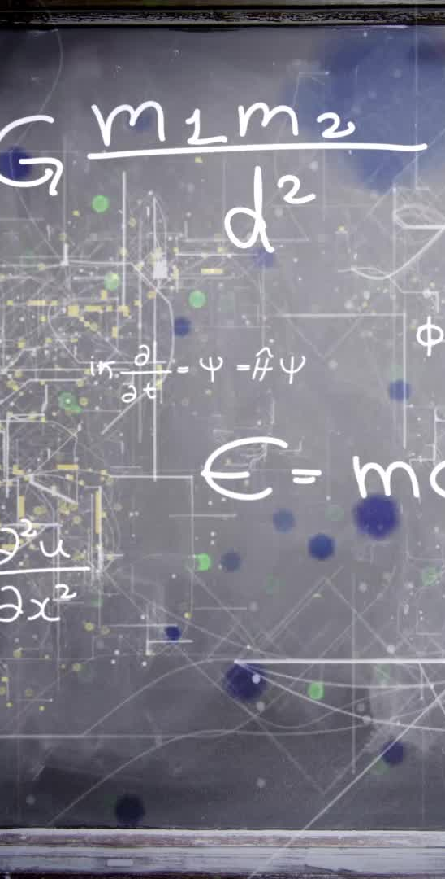
Divide-and-Conquer Method
Divide and Conquer algorithm has a cycle:
Divide: splits a problem into several sub-problems
Conquer: Subproblems are solved recursively. They attempt to be solved directly, but if not, they are broken down further
Combine: The solutions to the subproblems are merged or combined to form the solution to the original problem
Notes:
Lane is slides 5 through 8

Slide 6

Greedy (Kadane's Algorithm)
Greedy algorithm makes local choices in hopes that it will lead to a globally optimal solution. It can be boiled down to the following points:
Short-sighted: It never reconsiders its past decisions
Simplicity: It is generally easier to design and implement than dynamic programing or complex search algorithms
Speed: Because it avoids exhaustive searches or back tracking, making them very fast

Slide 7
2D Dynamic Programming Approach
Optimal sub-structure:
  An optimal solution to the problem contains optimal solutions to its subproblems
Overlapping subproblems:
  The same subproblems are solved repeatedly

Slide 8
Comparison Table of All Methods
Algorithms: | Running time: | Biotech Use Case | Strengths | Weaknesses
Divide and Conquer | O(n log(n)) | Hierarchical genomic region detection | Highly efficient for non-overlapping problems; often leads to O(n log(n)) solutions | Inefficient if subproblems overlap; high recursion overhead.
Greedy (Kadane’s Algorithm) | O(n) | Real-time biosensor or EEG analysis | Extremely fast at O(n) and simple to implement | Does not guarantee optimality for all problems; once a choice is made it can’t be undone
2D Dynamic Programming | O(m * n) | Hi-C maps, spatial tissue signal detection | Guarantees the globally optimal solution; handles complex dependencies and scoring system | High time and space complexity at O(n^2); impractical for very large inputs

Slide 9

Real Biotech Datasets
GEO, ENCODE, TCGA, 4DN, and more
Publicly available genomic data with large sample sizes
Used for study of DNA, such as mutation hotspots and sequencing
Some sources work better for certain algorithms
  i.e. HI-C Datasets are in the form of 2d Matrices
Notes:
Explain the publicly-available datasets and what they measure, what kind of signals are in them, etc.
Connect the three algorithms to some of them as examples

Slide 10
Synthetic Dataset Generation
Exists in the form of 1-D or 2-D matrices
Generated using Python’s NumPy library
Synthetic data provides a realistically-varied dataset, very customizable and easy to create
Ideal for program testing
Notes:
Overview of the synthetic dataset generation functions
Why synthetic datasets are useful for benchmarking a program
Show used algorithm from final code and result

Slide 11
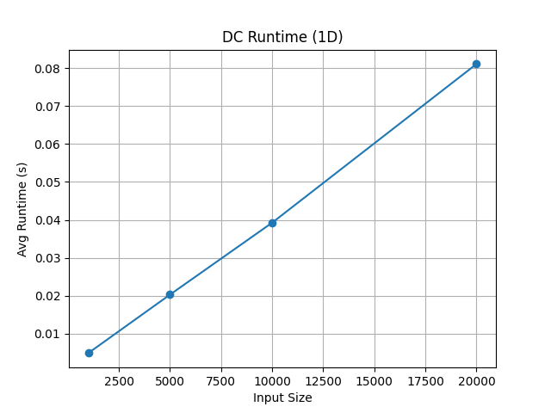
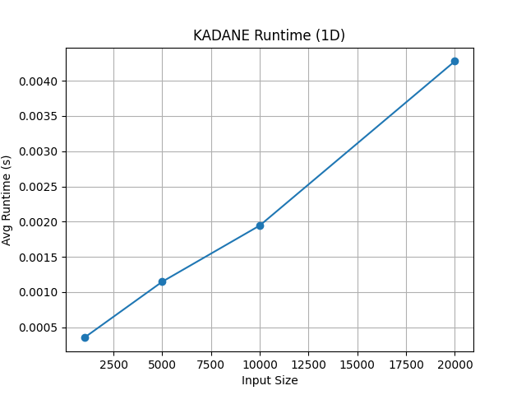
Algorithm Demonstrations
(1D DATASETS)
Notes:
Show charts produced by matplotlib
Explain relationship of time and input size, demonstrate code
Explain that the O(nlogn) relationship of the divide and conquer method isn’t really apparent except at higher array sizes that can take multiple minutes to simulate and are similar at a glance to le

Slide 12
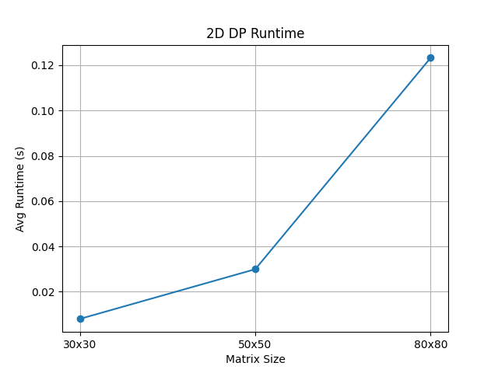
ALGORITHM DEMONSTRATIONS (2D DATASETS)
Array sizes:
  30x30 (900 elements)
  50x50 (2500 elements)
  80x80 (6400 elements)
2D Maximum Subarray is O(n³)
  Much more visible on this example
Notes:
- Ditto, show that O(n^3) curve is much more obvious at this scale

Slide 13
Conclusion + Future Work
Kadane’s Algorithm is confirmed to be most efficient by experiments
Can be used in a variety of 1d and 2d applications (as part of 2D Expansion)
Multiple uses in the biotech field
Others are still situationally useful
Notes:
Our experiments validated the documented behaviors of the methods, as they matched orders of growth closely
Kanade’s algorithm is generally the most time efficient for a 1D array due to having a linear order of growth
Reiterate the uses of Kanade’s algorithm in biotech analytics with examples
Reiterate that Kanade’s algorithm, despite being used in multiple solutions, is not a one-size fits all solution

Slide 14
Sources cited
  Generative AI (ChatGPT) was used in the process of formatting and doing final touch-ups on the program.
  Levitin, A. Introduction to The Design and Analysis of Algorithms. Pearson, 2012, 3rd Edition.

Slide 15
Questions?

